Slide 1
Automatic Image Captioning
CP2

Slide 2
Introduction Team
Hari Krishna Suguru
Kirthi Pakala
Manohar Rao

Slide 3
Overview
Objective: Build an image captioning model to generate captions of an image using CNN
Dataset: Flickr8k_dataset
Tools: Natural Language Toolkit, TensorFlow, Keras, Transformers,

Slide 4
Current State
Built 8K, 30K LSTM with Xception model
Flicker dataset
Built 8K, 30K CNN with Transformer model
Flicker dataset
Building Existing RESNET150 model
Coco dataset
Comparing performance metrics between models
Evaluated caption prediction with BELU score
Deployed Model in Flask and Ngrok
Code is uploaded in Github

Slide 5
CNN Transformer model
Image
CNN
ENCODER
DECODER
Output
Multi-Head Attention
Positional Encoding

Slide 6
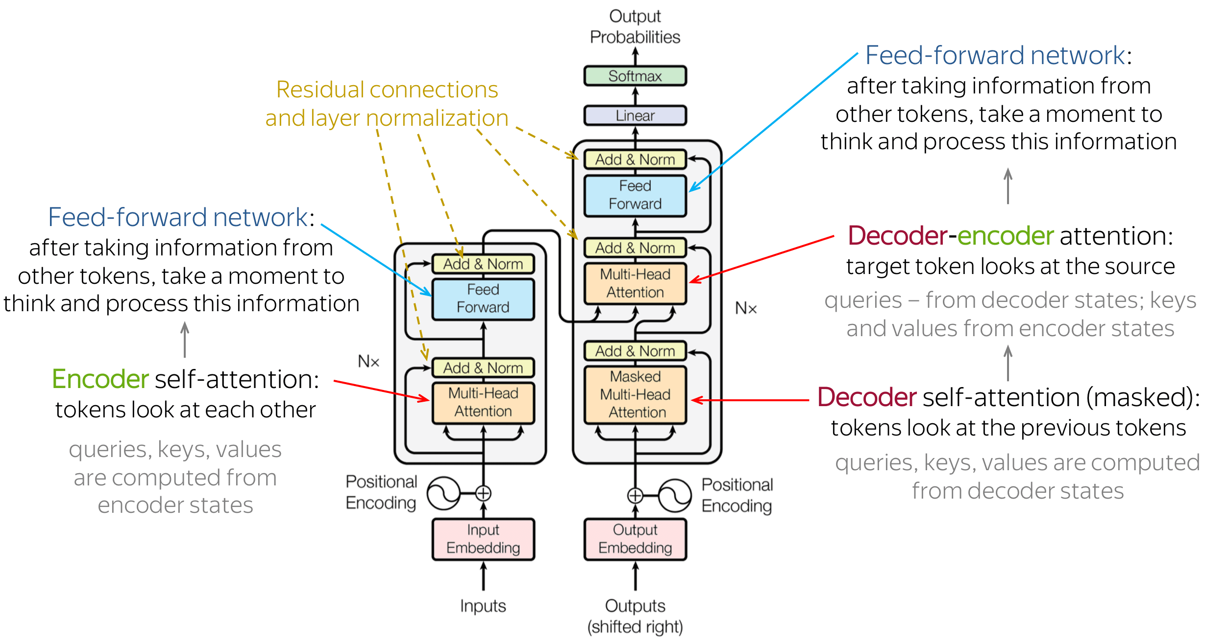
CNN Transformer model

Slide 7
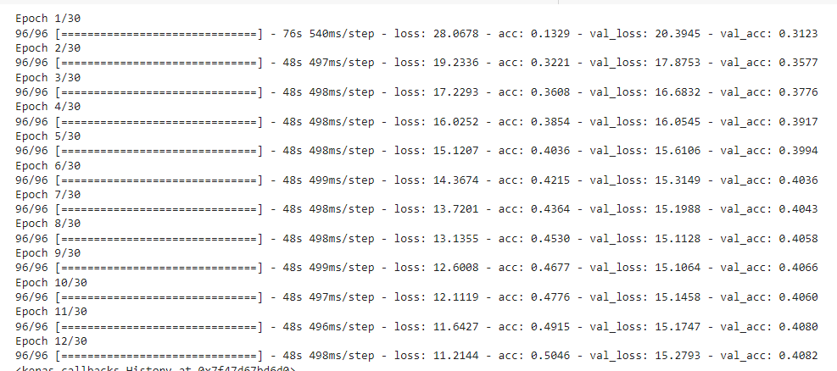
CNN Transformer Training

Slide 8
Metrics with Different models
Dataset | Architecture/model | Epoch | Accuracy | Loss | Validation Accuracy | Validation Loss | Bleu score
8K | LSTM | 10 | 0.35 | 2.7868 |  |  | 1.288
30K | LSTM 30k
8K | CNN-Transformers | 12 | 0.50 | 11.21 | 0.4002 | 15.5382 | 8.17
30K | CNN-Transformers 30k | 9 | 0.50 | 11.07 | 0.40 | 15.44 | 8.188 | Model is saturated at 9 epoch and thereafter reducing validation accuracy @30 loss: 8.3651 - acc: 0.5938 - val_loss: 17.7453 - val_acc: 0.3784
8K | RESNET150
30K | RESNET150

Slide 9
Model Deployment
Flask frame work for API
Ngrok – proxy for public access
Deployed saved mode in Flask

Slide 10

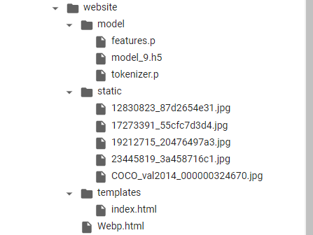
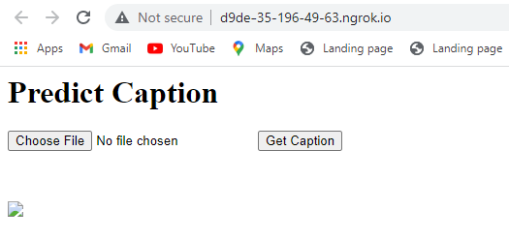
Model Deployment - UI

Slide 11
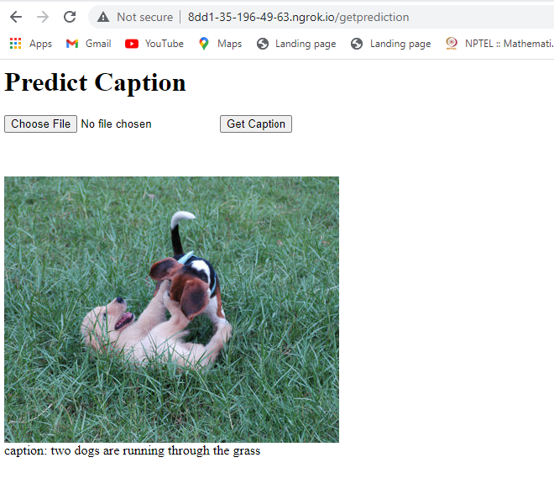
Model Deployment UI

Slide 12
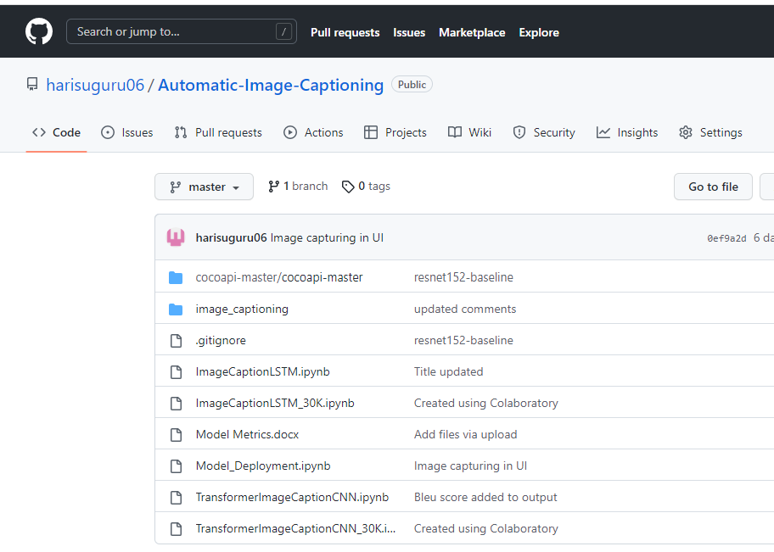
GIT

Slide 13
Challenges
For 30k training is taking long time and Google colab runtime is frequently disconnecting

Slide 14
Next Tasks
Fine tune models to improve accuracy
Experiment with different learning rates
Testing model
References
https://keras.io/examples/vision/image_captioning/
https://flask.palletsprojects.com/en/2.2.x/
https://ngrok.com/

Slide 15
Thank you

Slide 16
Stages In Machine Learning
Gathering Data
Downloading data https://cocodataset.org/#home
Train Images – 83K/13GB
Test Images – 41K/6GB
Preparing the Data
Transforming and resizing data
Choosing Model
RESNET-152 pretrained model
Common Object in Context (COCO) – Image recognition
Training
Training model with 5 epocs
Evaluation
Hyperparameter Turning
Prediction

Slide 17
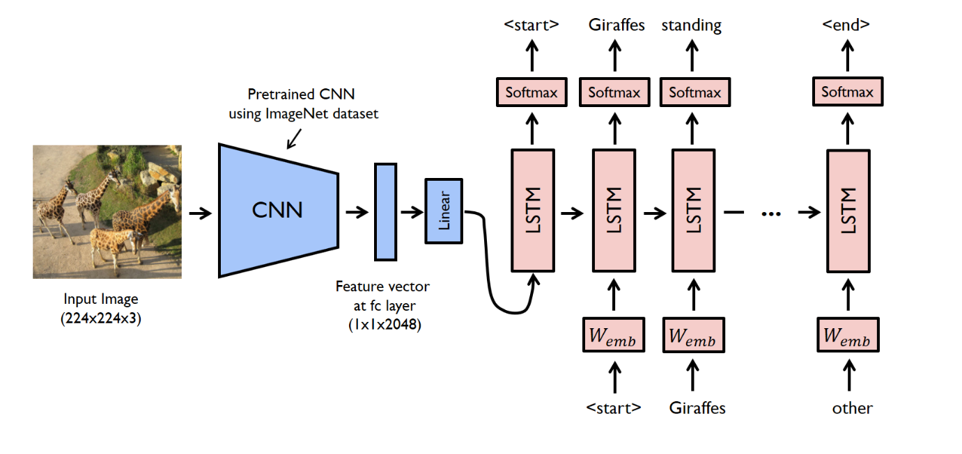
Architecture

Slide 18
Major Architecture components
nn.Module
COCO
--
Object Segmentation
Object Detection
EncoderCNN
--
Load Pretrained data
Remove Last Layer
Add FC layer
BatchNorm1d
DecoderCNN
--
nn.Embedding
nn.LSTM
nn.Linear
nn.LSTM
Vocabulary
--
Word2Index
Index2Word
Word Counter
Tokenize Sentences
Resnet152
--
Pretrained model
Pickle
--
Serialize object
Deserialize object

Slide 19
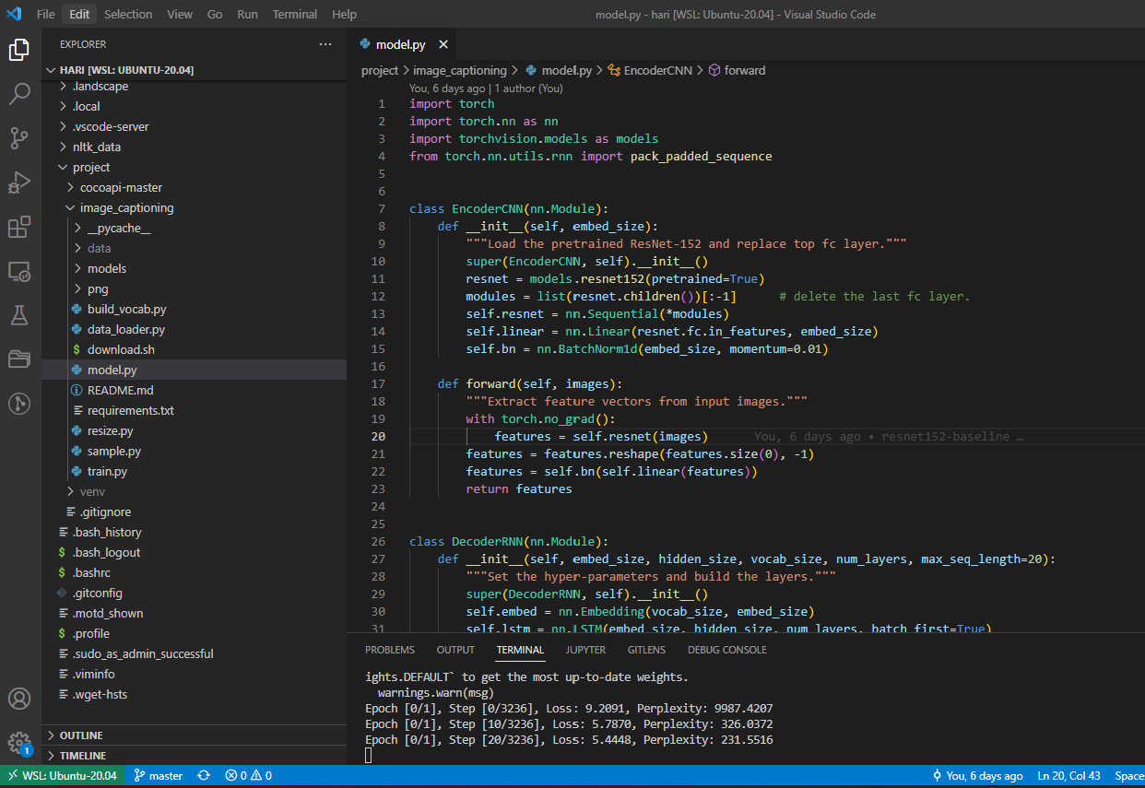
Building model in VSCode

Slide 20
Challenges
Existing sample has large data set i.e. 83K.
Training model with 5 epoc /128 batch size taking long time (days) in normal laptop
Some libraries are modified over a period of time, explored alternative to fix issues

Slide 21
Next Activities
Developing our own model and Train it on Flicker dataset
Predicting multi object text sentence
Enhance existing (RESNET150) model to RESNET 50
Benchmarking performance among the models

